Slide 1
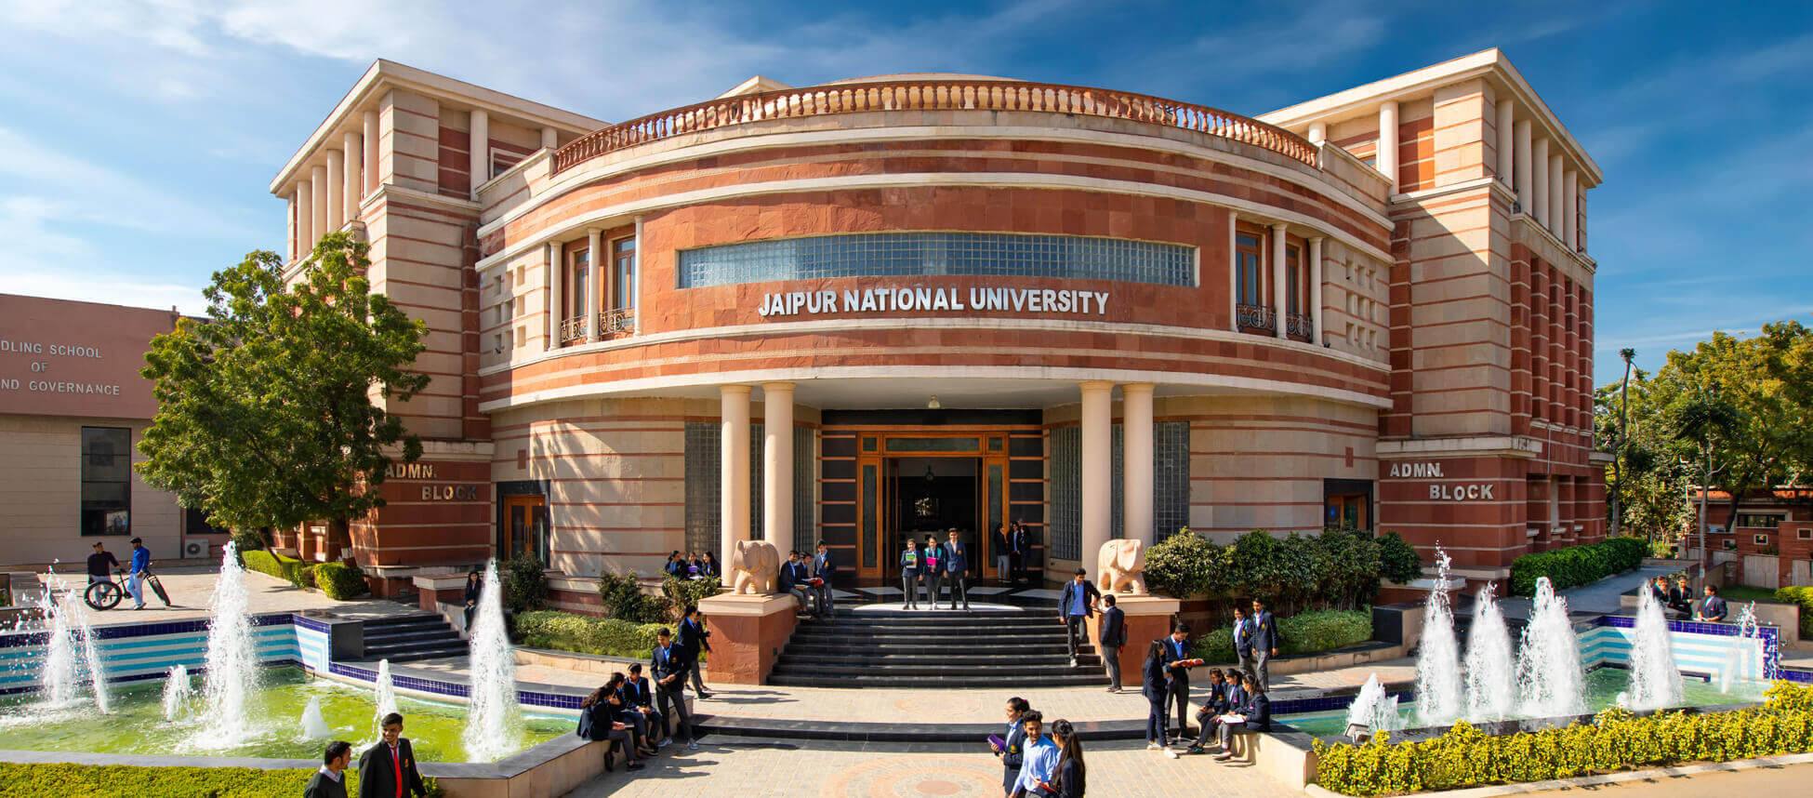
HOTEL
MANAGEMENT
SYSTEM
SUBMITTED BY:
SUBMITTED TO:
MOHAMMAD SHOAIB
ADITYA KUMAR JHA
PRIYANSHU RANJAN
KUNAL SINGH
MR.SURENDRA MEHRA
( ASSISTANT PROFESSOR)

Slide 2


Elite Inn
CONTENT
Introduction
Problem statement
Flow diagram
Implementation
Result
Conclusion
Content
Introduction
Problem statement
Flow diagram
Implementation
Result
Conclusion

Slide 3

Elite Inn
Content
INTRODUCTION
Problem statement
Flow diagram
Implementation
Result
Conclusion
Introduction
The project hotel management system is a web based application that allows the hotel manager to handle all hotel activities online. The hotel manager is a very busy person and does not have the time to sit and manage the entire activities manually on paper. This application gives him the power and flexibility to manage the entire system from a single online system.

Slide 4
Elite Inn
Content
Introduction
PROBLEM STATEMENT
Flow diagram
Implementation
Result
Conclusion
Problem statement
A hotel system manages information about rooms, reservations, customers, and customer billing. A customer can make reservations and order food through the this system.

Slide 5
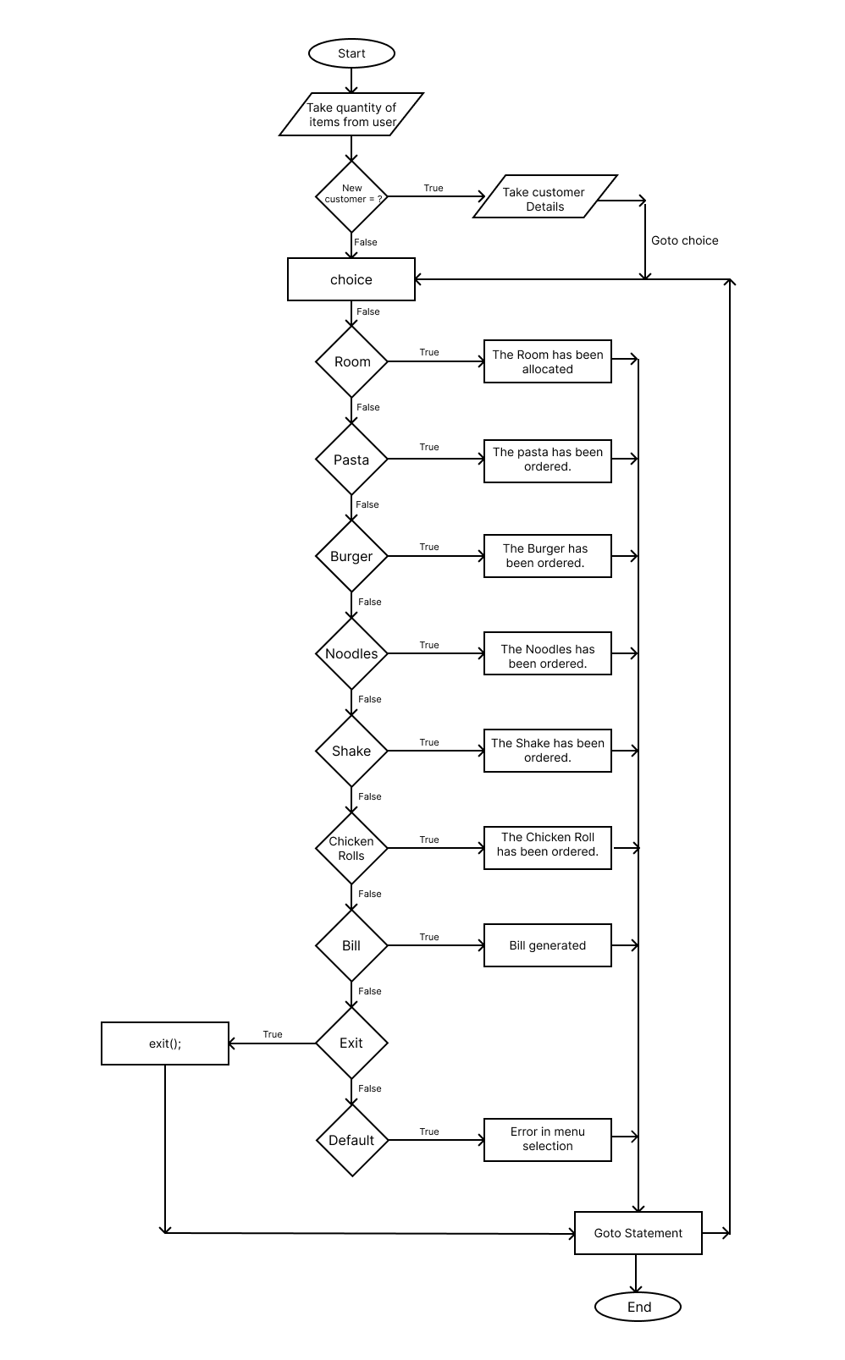
Elite Inn
Content
Introduction
Problem statement
FLOW DIAGRAM
Implementation
Result
Conclusion

Slide 6
Elite Inn
Content
Introduction
Problem statement
FLOW DIAGRAM
Implementation
Result
Conclusion

Slide 7
Elite Inn
Content
Introduction
Problem statement
FLOW DIAGRAM
Implementation
Result
Conclusion

Slide 8
Elite Inn
Content
Introduction
Problem statement
Flow diagram
IMPLEMENTATION
Result
Conclusion
Implementation
The availability of items is first requested by the programme.
Then inquire about the customer.
A menu with many options is displayed.
Use a goto statement.
Use a Switch case.
Goto : The goto statement is a control flow statement in programming that allows the program to jump to a labeled statement elsewhere in the code.
Switch case : Switch case is a control statement in programming used for multi-way branching. It evaluates an expression and executes a specific block of code based on the value of the expression.

Slide 9
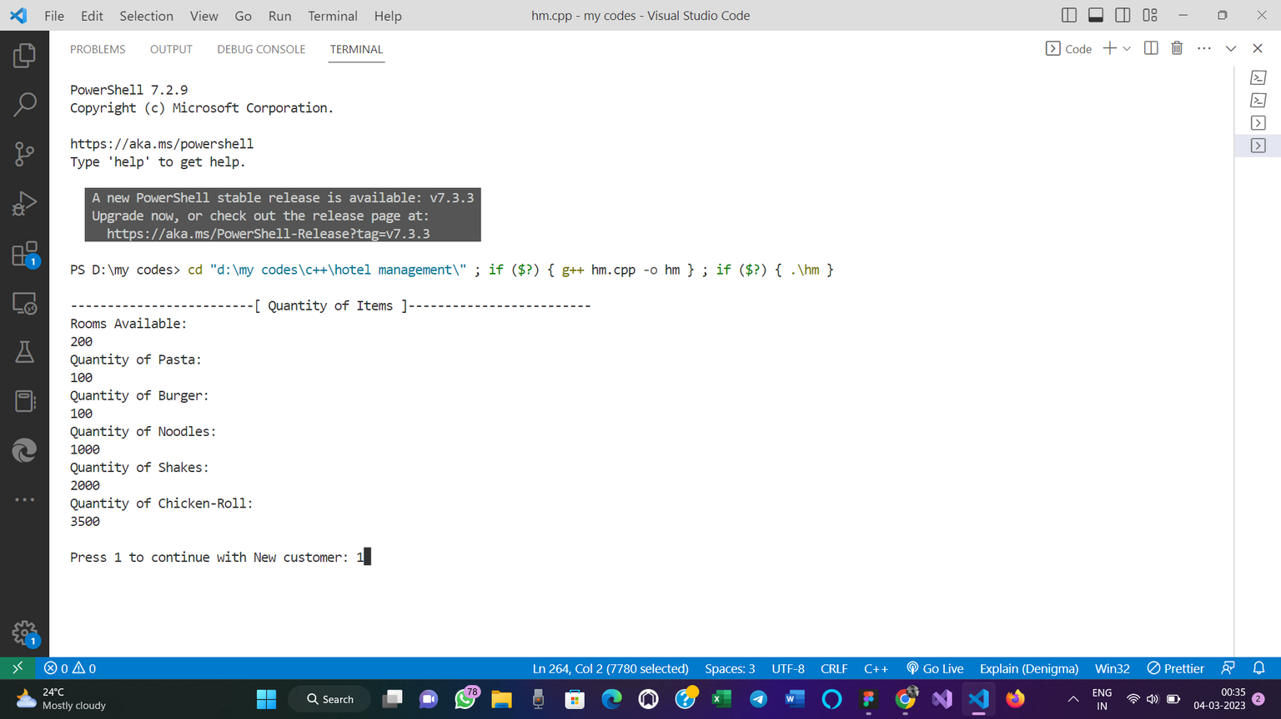
Elite Inn
Content
Introduction
Problem statement
Flow diagram
Implementation
RESULT
Conclusion
Result

Slide 10
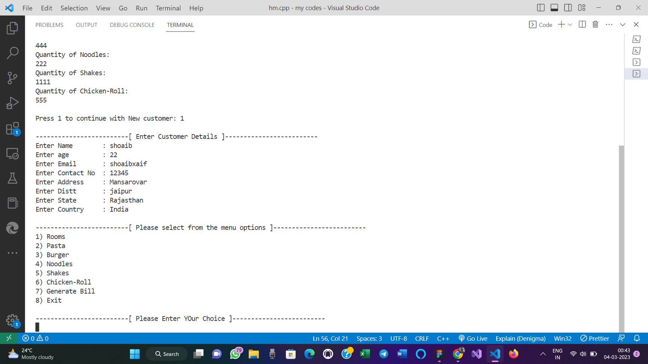
Elite Inn
Content
Introduction
Problem statement
Flow diagram
Implementation
RESULT
Conclusion

Slide 11
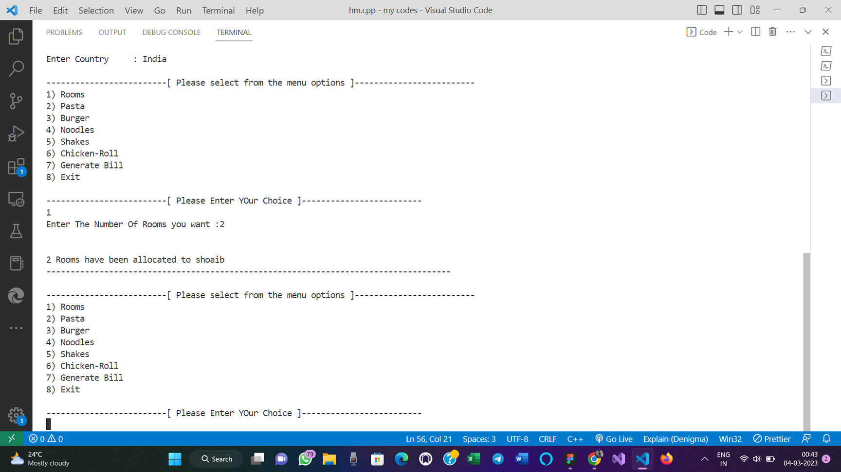
Elite Inn
Content
Introduction
Problem statement
Flow diagram
Implementation
RESULT
Conclusion

Slide 12
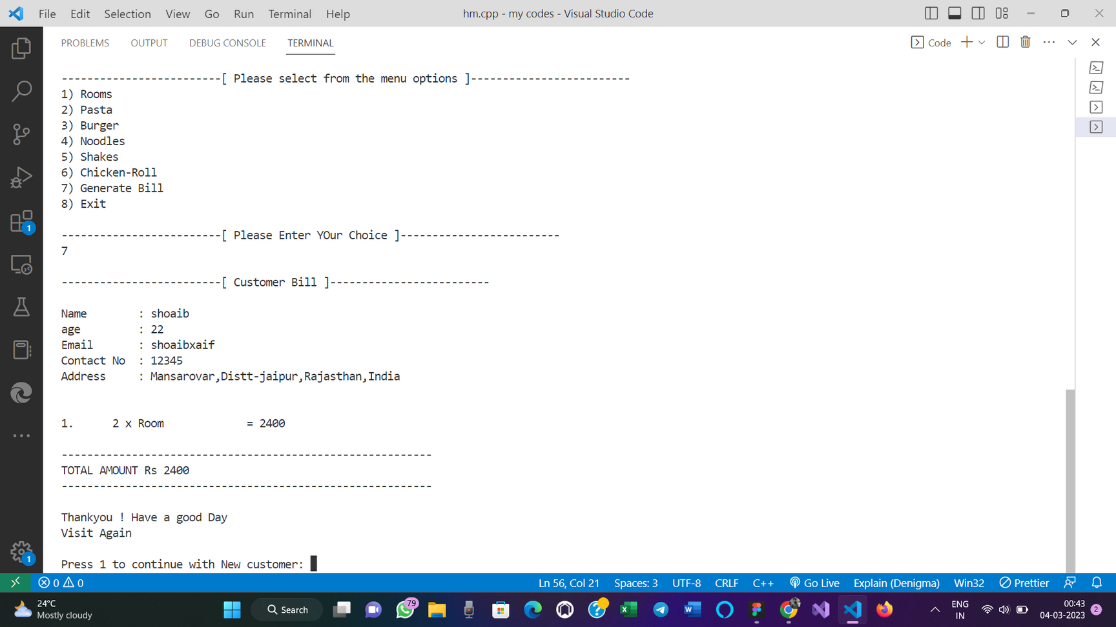
Elite Inn
Content
Introduction
Problem statement
Flow diagram
Implementation
RESULT
Conclusion

Slide 13

Elite Inn
Content
Introduction
Problem statement
Flow diagram
Implementation
Result
CONCLUSION
Conclusion
The system lets the user Know which rooms or food are available or not. This makes the Booking considerably faster. And thus helps the hotel in better management and reduce a lot of paper work as well as manpower. The hotel management system provides the quality service to the end user.

Slide 14



Updated system with UI

Slide 15
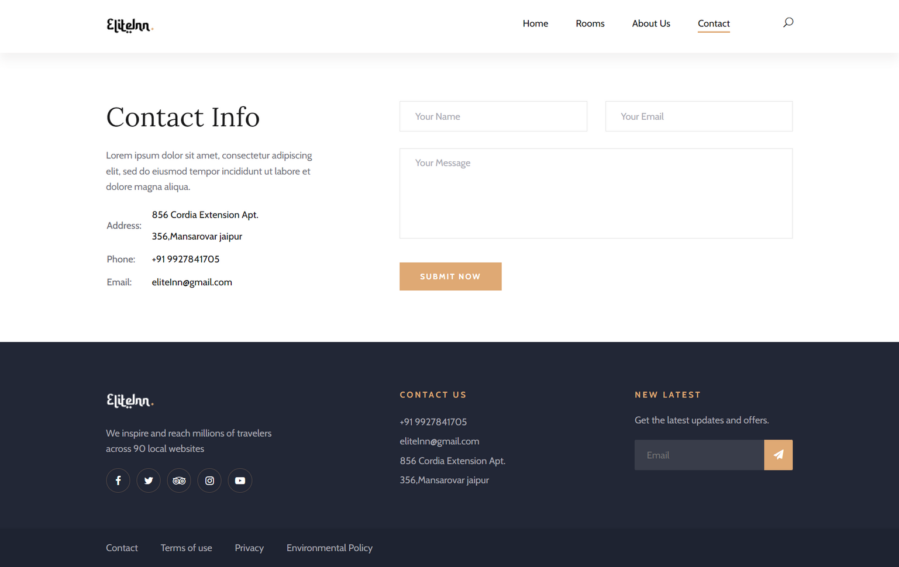
Updated system with UI

Slide 16

Thank you!

